Slide 1
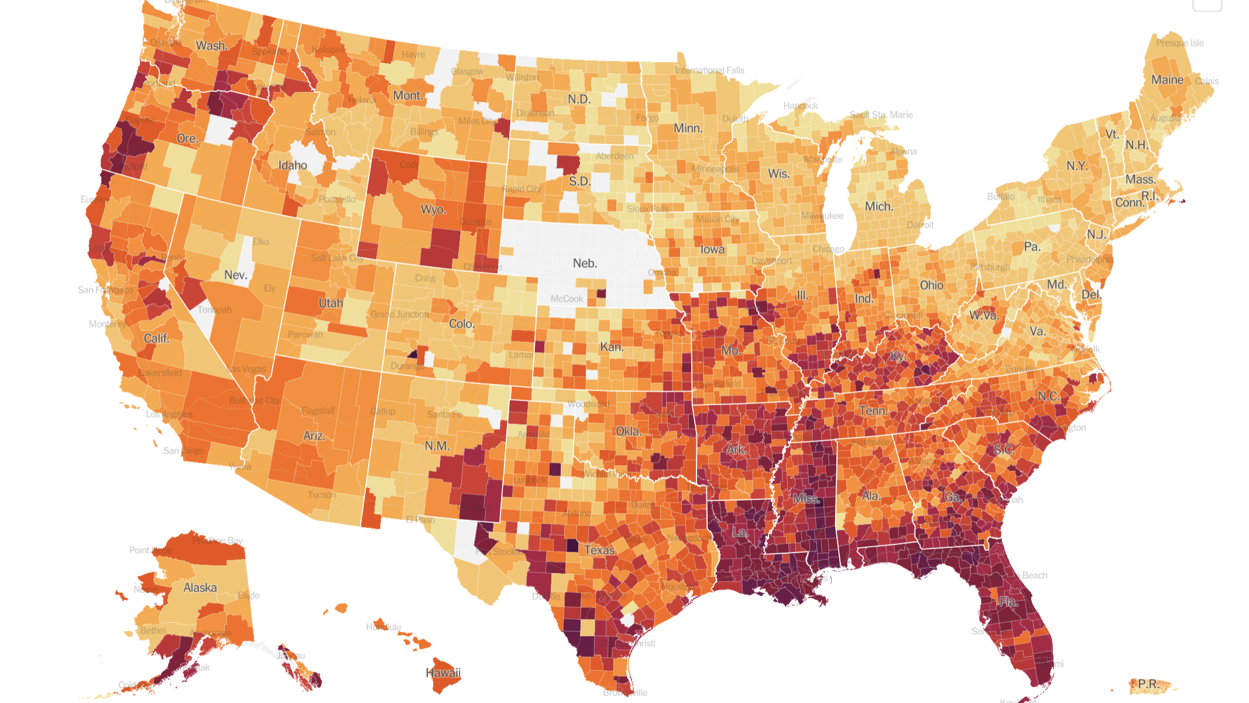
COVID-19 Diagnosis Prediction

Slide 2
Agenda
Motives and objectives of our project
Data exploration
Data preprocessing & feature selection
Imbalanced data handling: sampling
Modeling
Notes:
to predict the corona test results based on the provided symptoms displayed by the people and find the most effective model.

Slide 3
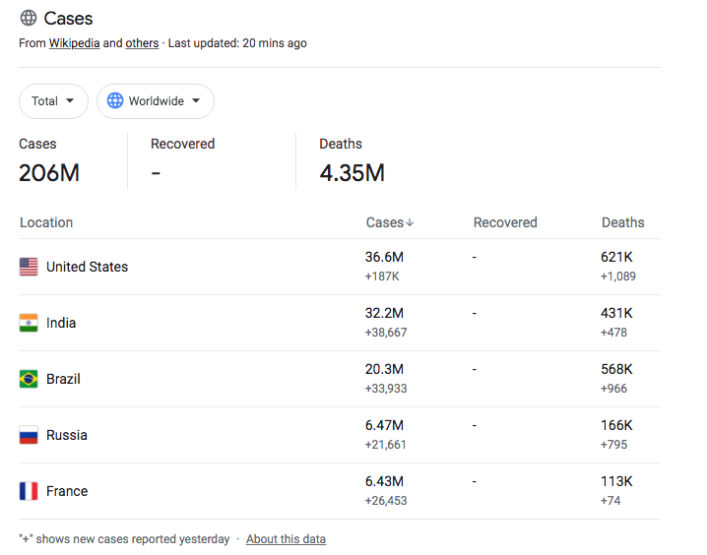
COVID-19 Worldwide Cases
Notes:
Worldwide Cases as of 8/14/2021
· This data is provided by Wikipedia, The New York Times, Our World in Data and JHU CSSE COVID-19 Data.

Slide 4
COVID-19 Delta Variant
The Delta variant causes more infections and spreads faster than earlier forms of the virus that causes COVID-19. It might cause more severe illness than previous strains in unvaccinated people.
Vaccines continue to be highly effective at preventing hospitalization and death, including against this variant.
Fully vaccinated people with breakthrough infections from this variant appear to be infectious for a shorter period.
Get vaccinated and wear masks indoors in public spaces to reduce the spread of this variant.
Notes:
Sourced from: https://www.cdc.gov/coronavirus/2019-ncov/variants/delta-variant.html
In late June, our 7-day moving average of reported cases was around 12,000. On July 27, the 7-day moving average of cases reached over 60,000. This case rate looked more like the rate of cases we had seen before the vaccine was widely available.

Slide 5
How to predict whether you have COVID-19 or not with supervised learning?
Notes:
What questions are being addressed?
Are your questions descriptive or predictive? Predictive
the problem supervised or unsupervised? Supervised
What is the impact of solving this problem? Hoping to determine if there's a better way to identify covid-19 patients

Slide 6

Data Exploration

Slide 7
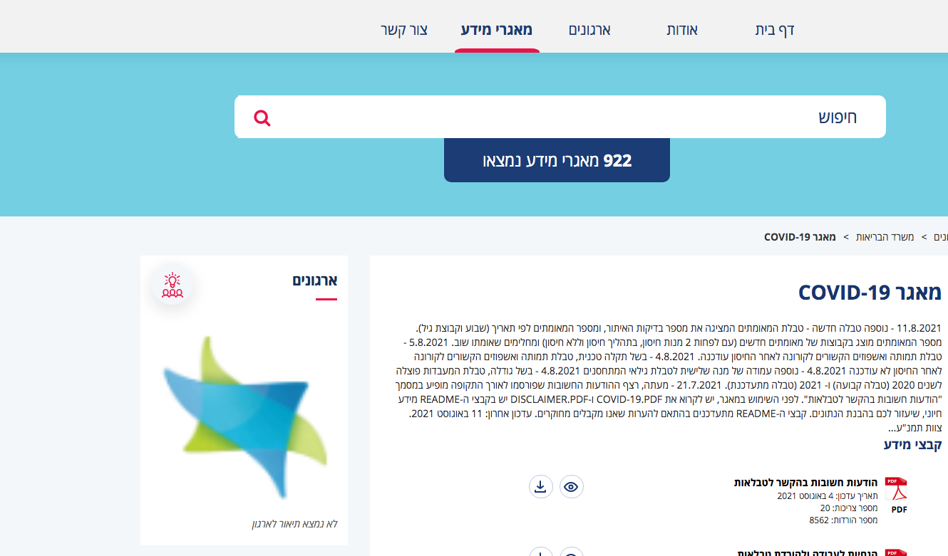
Israel Government Databases – COVID-19
https://data.gov.il/dataset/covid-19
Notes:
The Ministerial Committee for the Improvement of Government Service to the Public, decided in 2010 on the development of the data.gov.il project in order to promote the policy of open government in Israel.
Website and data is in Hebraw
https://data.gov.il/dataset/covid-19/resource/0ac4cffc-3746-473a-8d4a-ab874b8d8d62
Due to the COVID-19outbreak, citizens began gettingtested for the virusin February 2020.

Slide 8
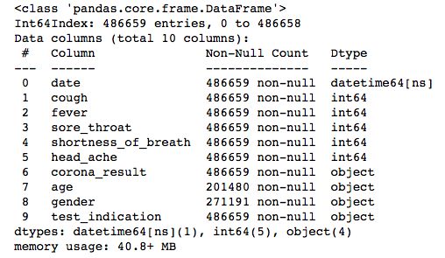
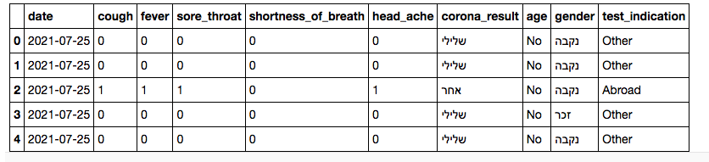
COVID-19 Data
Notes:
Due to the COVID-19outbreak, citizens began gettingtested for the virusin February 2020.
This table shows daily data fromthe first tests of citizens tested (age and sex), test results, and indications for testing(staying abroad, clinical symptom.
Important clarifications regarding symptoms:
1.Symptoms are based on self reporting
2.Due to patient confidentiality, only the 5 most prevalent symptoms appear, although there are more symptoms
3.Thereis an inherent reporting bias as the data is collected differently from positive and negative results:oFor positive results, a comprehensive epidemiological investigationwas made, with specific questions regarding symptoms;oFor negative results,the data were notcollected consistently and notthroughdirect questioning.
4.Clinical symptoms were not always an indication for testing. For example, at the onset of the outbreak, if a person returned from certaincountries or a person was in contact with someone diagnosed with the virus, symptoms were not required for testing.
5.Some surveys were performed in select populations (such as health workers) –in these cases clinical symptoms were not recorded.
6.There are reports in literature of a-symptomatic carriers.
7.The value 0 under symptoms represents both no symptoms and NULL sym
Explanation of variables in the table:
1.test_date: Arrival date of the test at the lab in DD/MM/YY format
2.gender: test taker's sex: male/female/ NULL (unknown); appears fromMarch22nd2020
3.Corona_result: Results of first Covid-19 test, by category:
a.Positive –carrying Covid-19b.Negative –not carrying Covid-19c.Other –Not tested, in testing, inconclusive
4.Age_60_and_above: Indicator of the test taker'sage -60 or over (1) or below 60 (0). Appears from March17th2020.
5.cough: Did cough symptoms appear before testing? 1 –Yes, 0–No, NULL –Unknown
6.fever: Did fever appear before testing? 1 –Yes, 0 –No, NULL –Unknown
7.Sore_throat: Did sore throat symptoms appear before testing? 1 –Yes, 0 –No, NULL –Unknown
8.Shortness_of_breath: Did cough shortness of breath symptoms appear before testing? 1 –Yes, 0 –No, NULL –Unknown
9.Head_ache: Did headache symptoms appear before testing? 1 –Yes, 0 –No, NULL –Unknown
10.Test_indication: What is the indication for testing? Abroad –arrived from abroad, contact_with_confirmed –contact with aconfirmed case, other –other indication or not specified

Slide 9
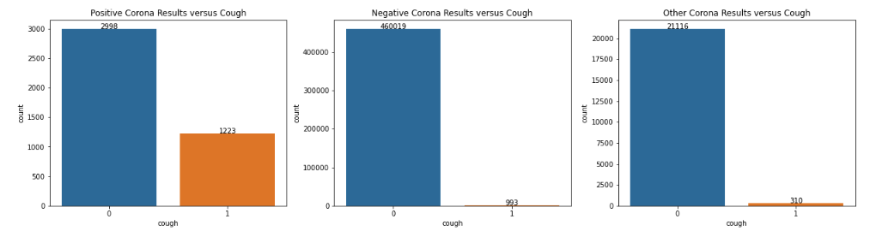
Breakdown of Cough

Slide 10
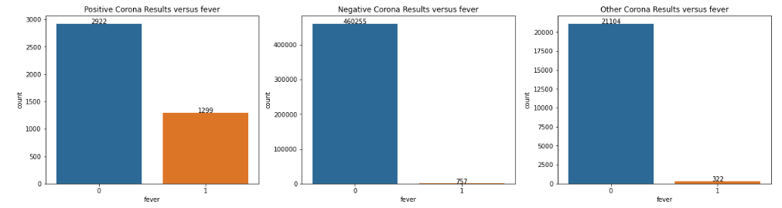
Breakdown of Fever

Slide 11
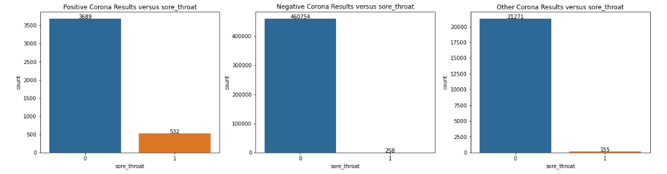
Breakdown of Sore Throat

Slide 12
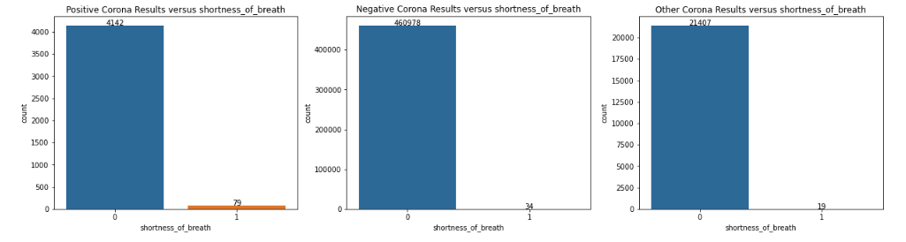
Breakdown of Shortness of Breath

Slide 13
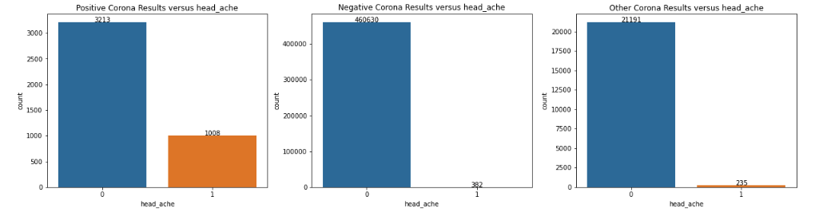
Breakdown of Headache

Slide 14
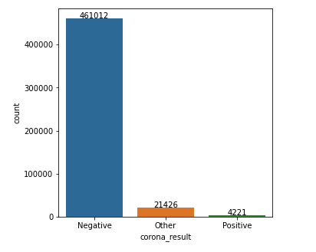
Imbalanced Dataset

Slide 15
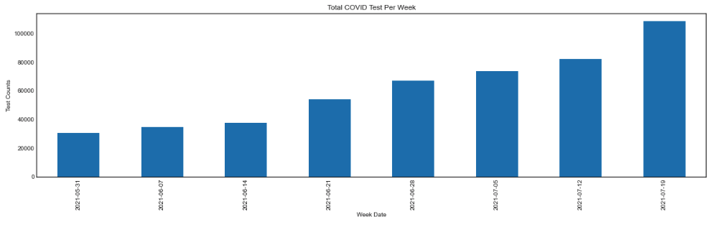
COVID Test Per Week
Notes:
Weekly upward trend

Slide 16

Data preprocessing

Slide 17
Features with null values
Feature | Total | Percent
age | 275466 | 0.592103
gender | 208245 | 0.447614

Slide 18
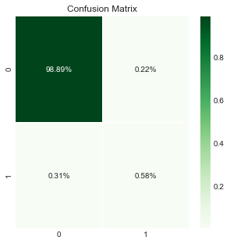
Original performance
 | Method | Original
0 | Balanced Accuracy | 0.824516
1 | Sensitivity | 0.994691
2 | Specificity | 0.654340
3 | AUROC | 0.824516
4 | F1 | 0.684547
5 | Geometric Mean | 0.806763
6 | Macro Average MAE | 0.175484

Slide 19

Feature Selection

Slide 20
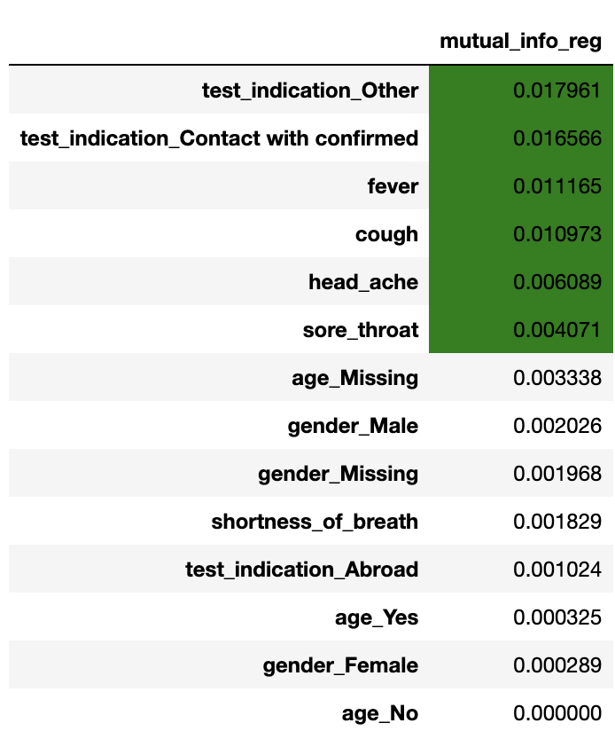
Mutual information

Slide 21
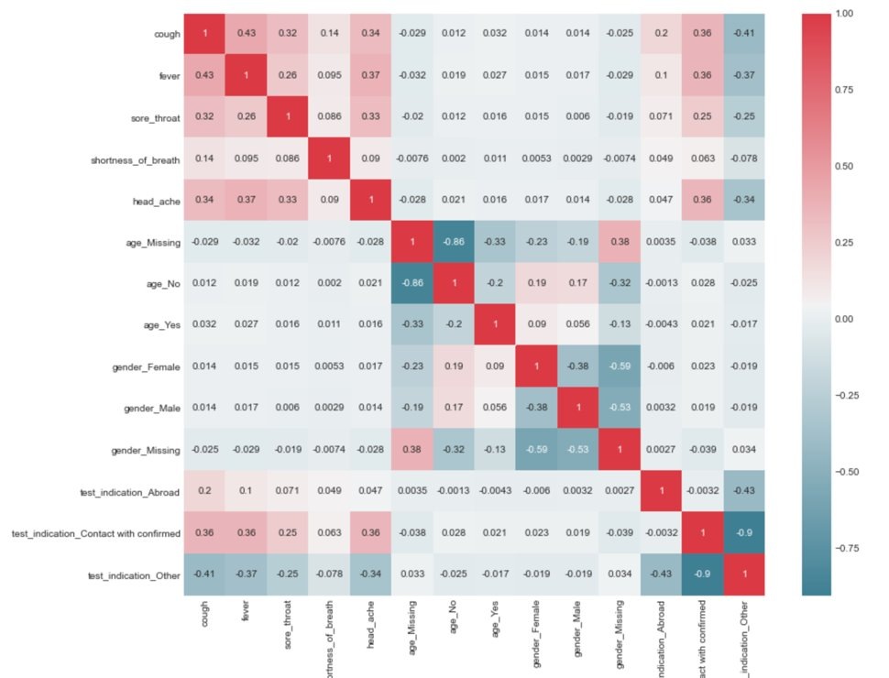
Correlation matrix

Slide 22
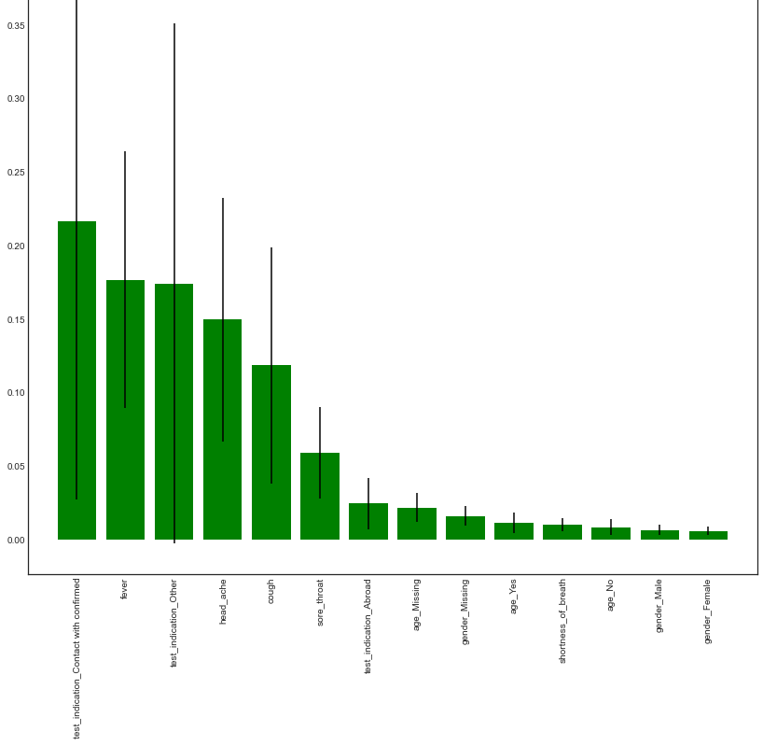
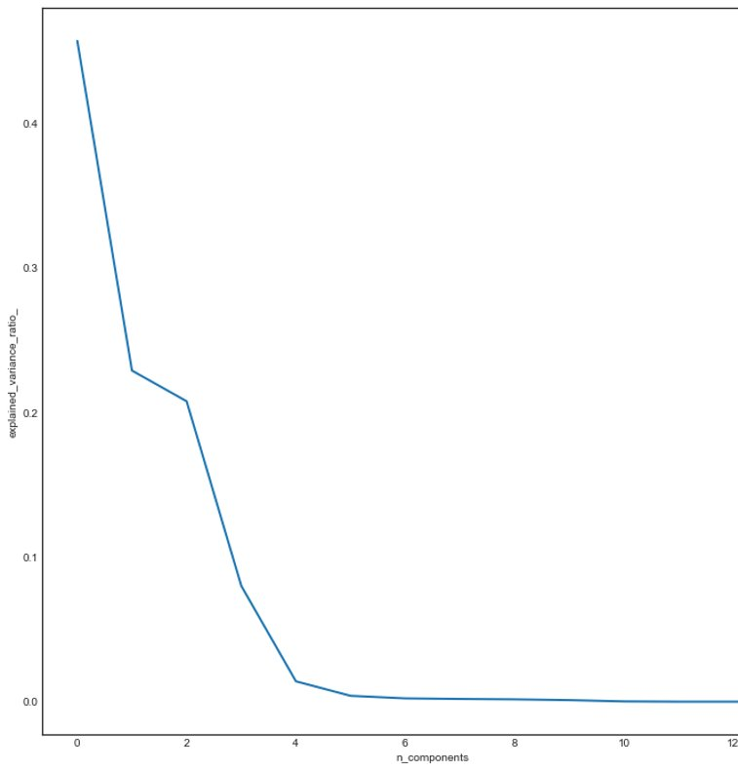
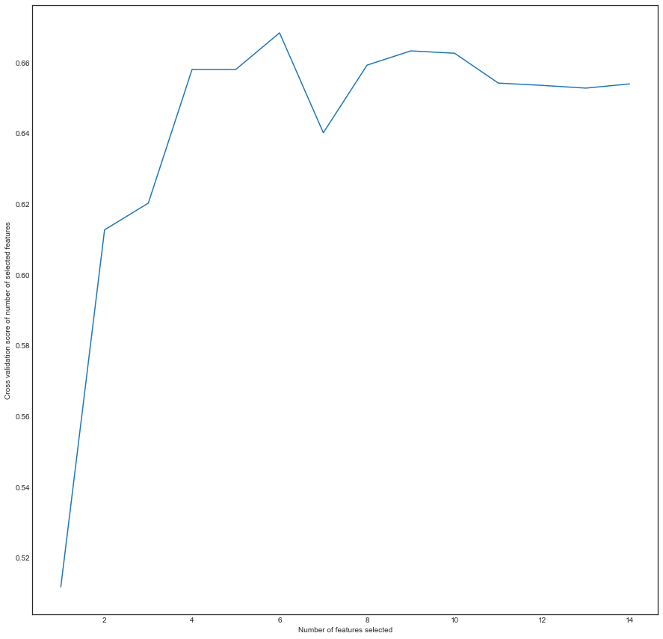
How many features should be selected --feature importance, PCA, REFCV

Slide 23
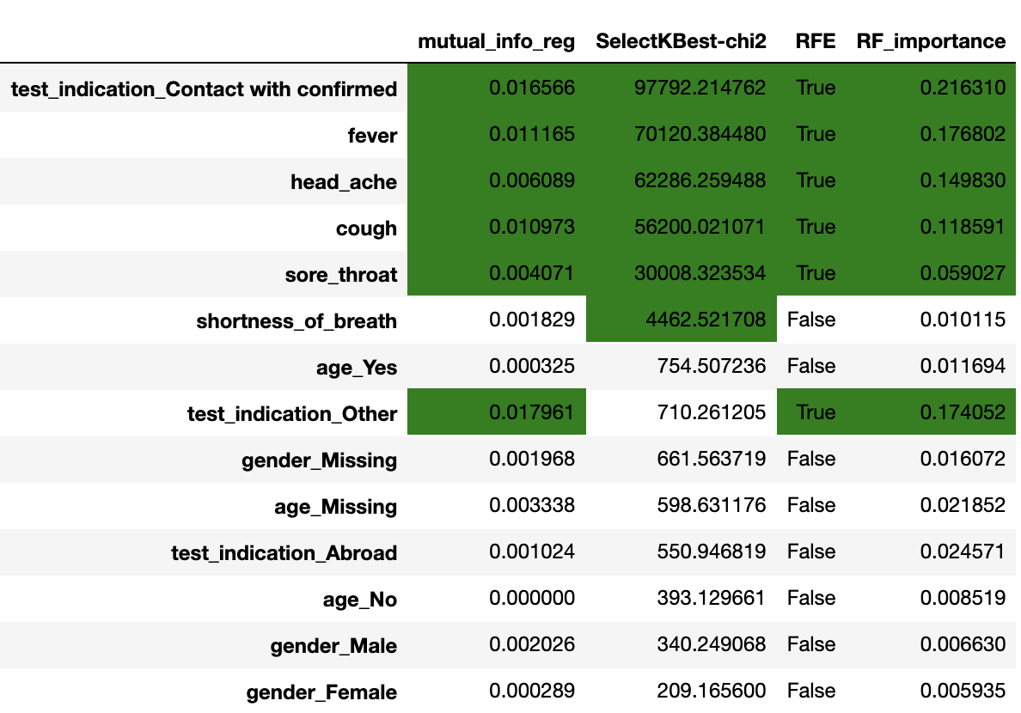
Which features should be selected

Slide 24
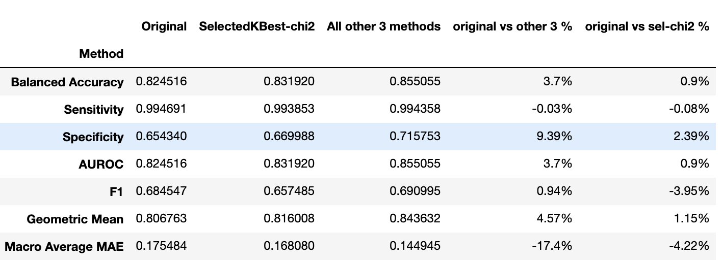
Finalizing the 6th feature

Slide 25
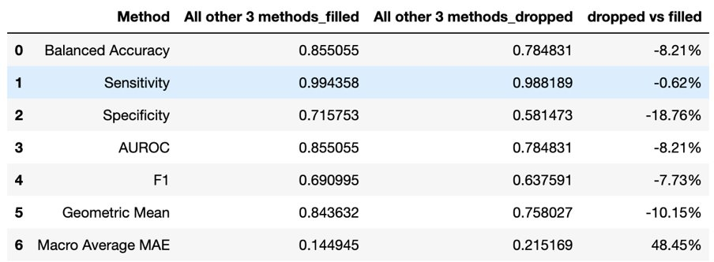
Filled vs dropped

Slide 26

Sampling & Modeling with imbalanced data

Slide 27
Sampling with imbalanced data
OverSample (Random over sample) Randomly duplicate the samples which are under-represented
SMOTE (Synthetic Minority Oversampling Technique) Generate new samples by interpolation
UnderSample (Random under sample) Randomly downsize the samples which are over-represented
Notes:
This covid 19 dataset is highly imbalanced with most of class being negative and only 1% being postive. Beside using specific metrics for imbalanced data, we could leverage the special sampling methods especially for imbalanced data. We can either use oversampling to increase the number of under-represented class or use undersampling to reduce the number of majority class. There is also a variant sampling method of oversampling we will use called SMOTE (Synthetic Minority OverSampling Technique) and ADASYN.

Slide 28
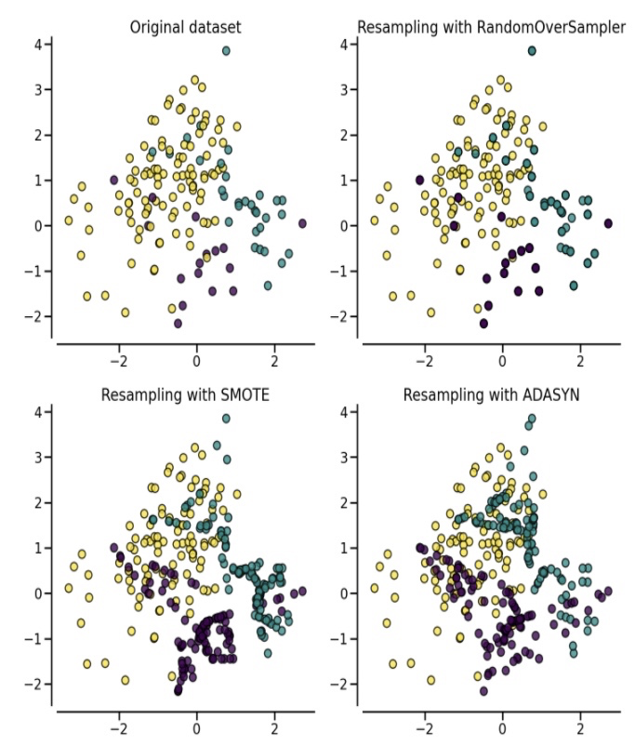
Sampling with imbalanced data
Random Sampler simply duplicates or deletes samples while the SMOTE Sampler generates new samples by creating similar samples next to original samples.
Notes:
We will use different sampling method and comparing their performance with the original smaples.

Slide 29
Modeling
Perceptron
Decision Tree
Gaussian Naïve Bayes
Random Forest
GradientBoostingForest
XGBoost
Nerual Network
Dummy Classifier
Most Frequent Classifier
Notes:
We will cover several kinds of main stream models to see what difference in performance they can make in our dataset.
They include Perceptron, …..... We will also include dummy classifier which will classify samples randomly and most frequent classifier which will predict samples to be the majority class as we know the expected accuracy will be high due to the imbalanced classes in the original samples. These two models serves as basic performance reference in our modeling
And the parameters of these models are tuned to be optimal through demo tests.

Slide 30

Modeling
For implementing each Sampling method, repeating following steps:
Using Stratified K-Fold splitting (k = 10) method to split train-test samples
For training data, using different sampling method (over sample, SMOTE, under sample) to resample the training data and keep test data intact.
Run model to fit and predict for each model and record the metrics (for training data and test data)
Calculate the average metrics for 10 folds.

Slide 31
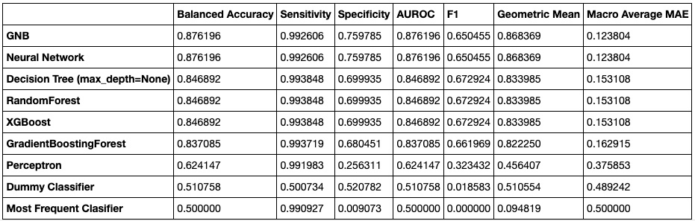
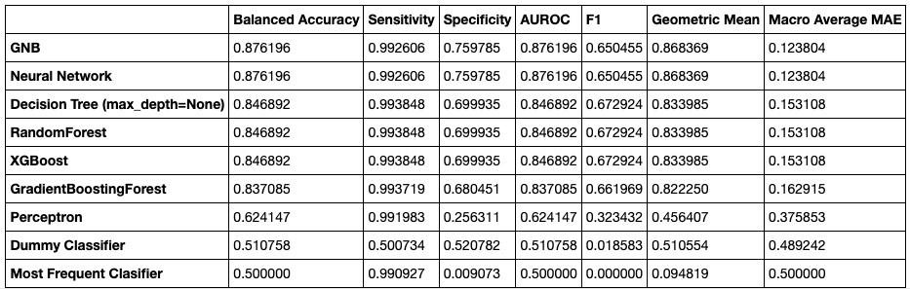
Performance (original sample)
Test dataset
Train dataset
Notes:
We have got some meaningful results. We sort the model by their AUROC in descending order. And we display the performance for test data and training data together.
Firstly, for the original sample, the Neural Network algortihm and GNB has the best performance in overall but the difference from other models is nuanced except for the Perceptron which has a bad performance. Of course the two basic classifiers has the worst performance.
What's more, the performance in test data and train data is nearly the same, which means the models are not overfitting. They have same performance in test data and train data.

Slide 32
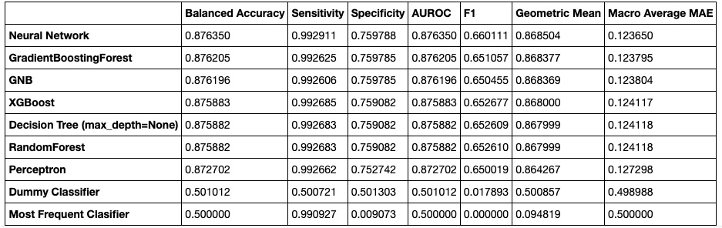
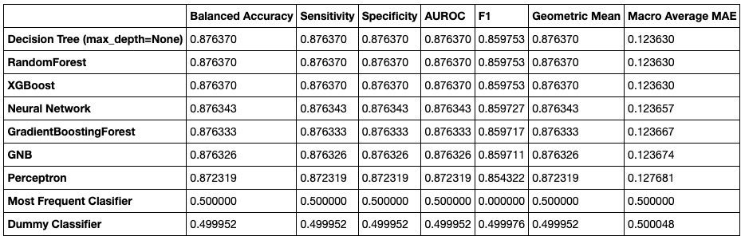
Performance (random over-sample)
Test dataset
Train dataset
Notes:
This is the performance from random over sampling
Similar results!!! Neural network is the best and two basic classifiers are the worst. But with oversampling:
1) the perceptron's performance is aligned with others
2) the performance in train dataset is better according to the F1 score, which means the models may be over-fitting on the train-data.

Slide 33
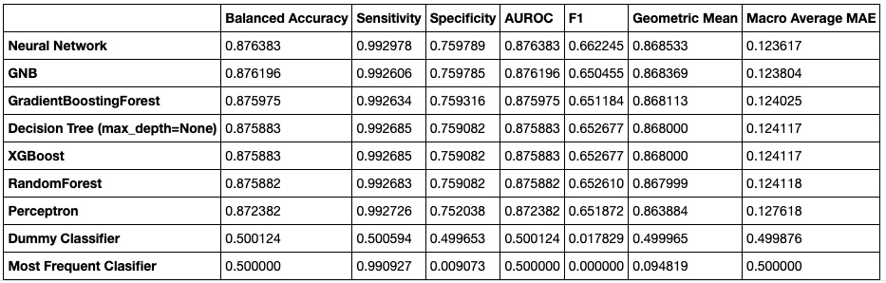
Performance (SMOTE)
Test dataset
Train dataset
Notes:
Here is the performance from sampling using smote technique and there isn't much difference comparing to other sampling method.
However, our models perform the same in train data and test data

Slide 34
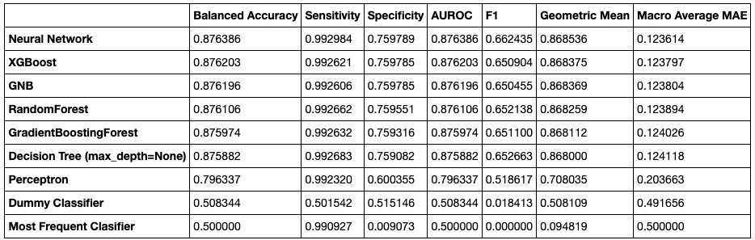
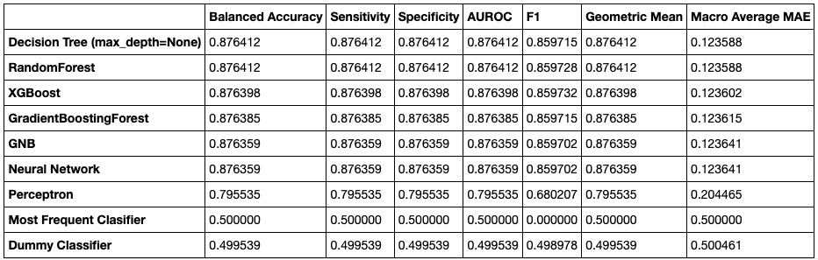
Performance (random under-sample)
Test dataset
Train dataset
Notes:
And again!!! This is the performance from random under-sampling
The results is almost the same except that the perceptron model is slightly worse than other models. And the two dummy classifiers are the worst certainly.

Slide 35
Conclusion
Sampling method | Best Model | Performance (AUROC %)
Original Sampling | Neural Network, GNB | 87.62
Oversampling | Neural Network | 87.64
Oversampling with SMOTE | Neural Network | 87.64
UnderSampling | Neural Network | 87.64
The best performance we can get is from Neural Network.
Possible reasons for the current performances
hidden pattern in the data changes over time (virus mutation)
superficial and binary features can't guarantee a reliable prediction
Notes:
Say if we have patients with exactly same symptoms, can we definitely determine whether the diagnosis is positive or not. Of course not, and there are many cases that the results are not same though they have same symptoms.

Slide 36

Stay healthy and thank you!

Slide 37
Reference
https://github.com/guojunseven/Data-Mining-Project/blob/master/COVID19%20Diagnosis%20Prediction.ipynb
https://www.kaggle.com/kanncaa1/feature-selection-and-data-visualization
https://www.kaggle.com/prashant111/comprehensive-guide-on-feature-selection
https://imbalanced-learn.org/stable/references/metrics.html#module-imblearn.metrics
https://en.wikipedia.org/wiki/Template:COVID-19_pandemic_data
https://www.nytimes.com/interactive/2021/us/covid-cases.html
https://ourworldindata.org/coronavirus-data
https://github.com/CSSEGISandData/COVID-19
https://www.cdc.gov/coronavirus/2019-ncov/variants/delta-variant.html
https://imbalanced-learn.org/stable/over_sampling.html#naive-random-over-sampling
ß

